Slide 1
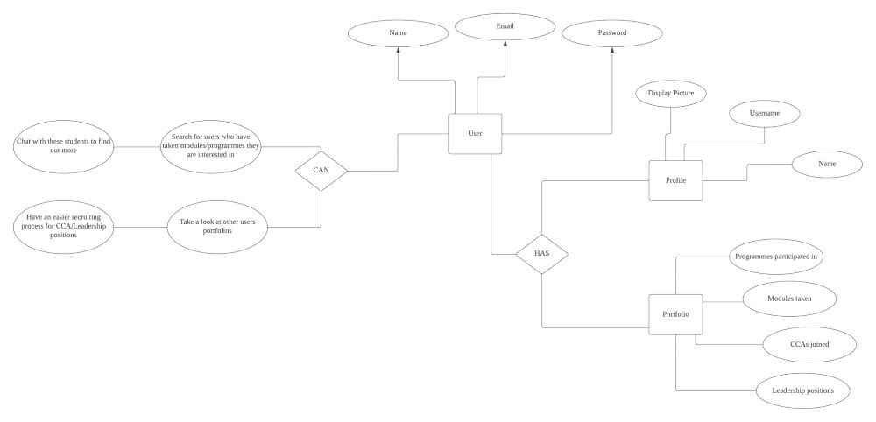
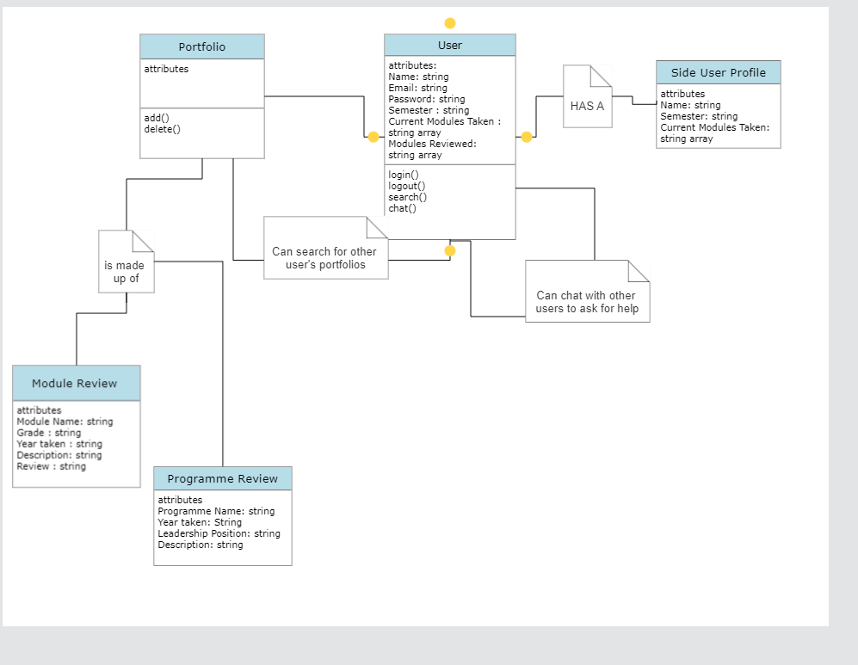
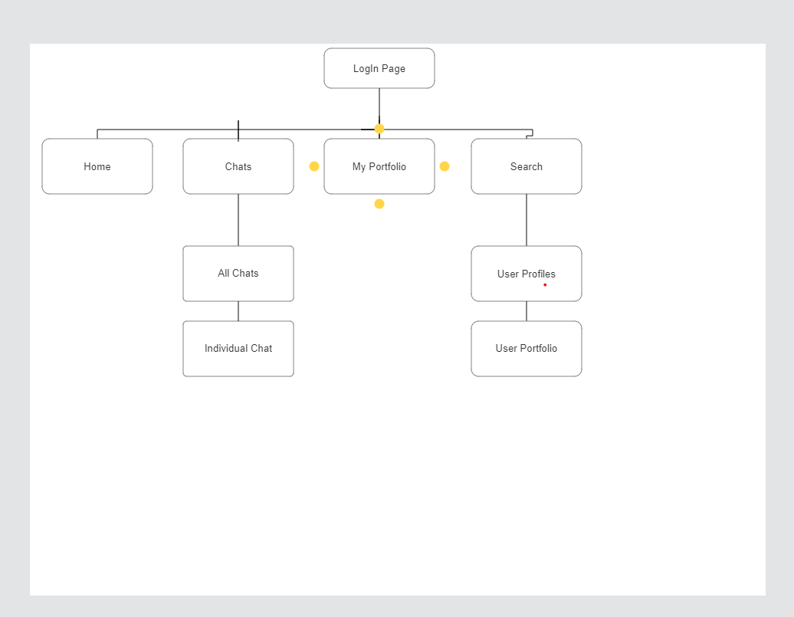











About
LinkedNUS is a web-application that provides students with a platform to ask seniors/peers for help or information of a particular module or program to make University life easier.
Diagrams
Features
User Account Authentication
Auto-generated personalised side profile
My Portfolio
Search function
Editing Portfolio Entries
Deleting Portfolio Entries
Tech Stack:
Personalised Side Profile
We are simulating having NUS’ database of students based off their emails. As such, we will be able to auto-generate these students’ names, current semester as well as current modules that they are taking and display them at the sidebar.
My Portfolio
Every user has their own portfolio page which allows them to add, edit or delete reviews from modules/programs that they have taken or participated in. Here, users let other users know their brief experience and reviews.
Search Function
Using the search bar, users can key in programs or modules that they want to find out more on. A list of students who have taken that particular module will be then presented to the user.
Contact Users
Upon arriving at a student’s portfolio, their side profile will contain their personal email. Users can then use this email to contact said peers or seniors to ask about the module. Their queries and questions of the module will then be answered by their senior. They can further discuss other matters from there on.

